Slide 1
Saurabh Shrestha Data Visualization DSC 640

Slide 2
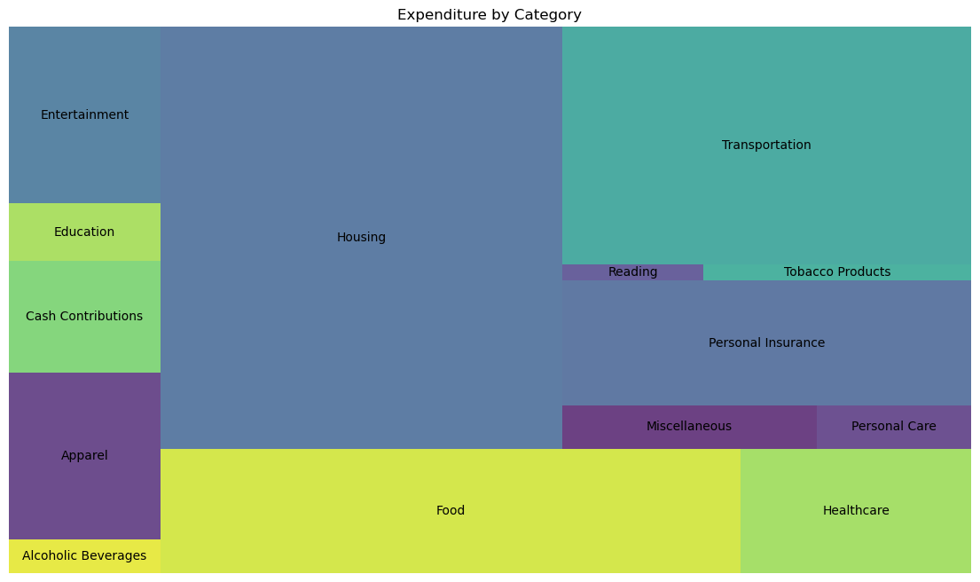
Python – Tree Chart

Slide 3
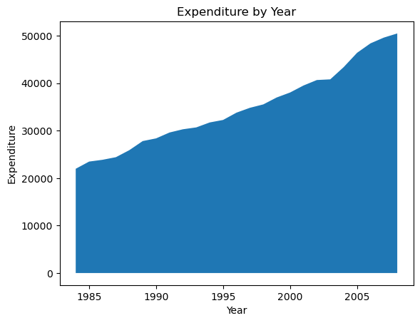
Python – Area Chart

Slide 4
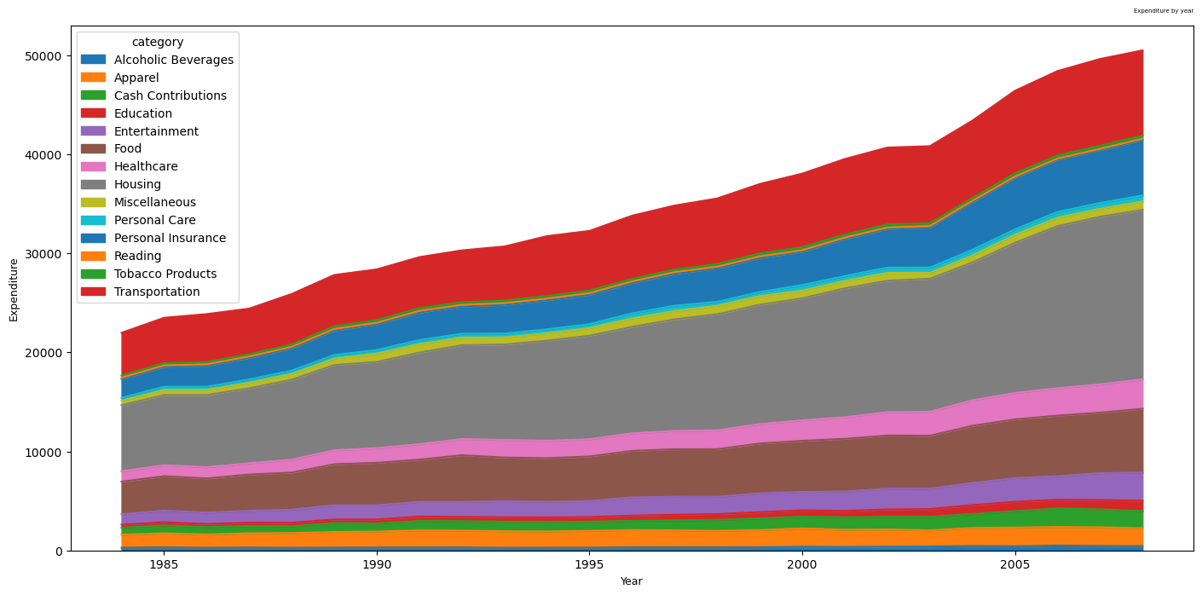
Python – Stacked Area Chart

Slide 5
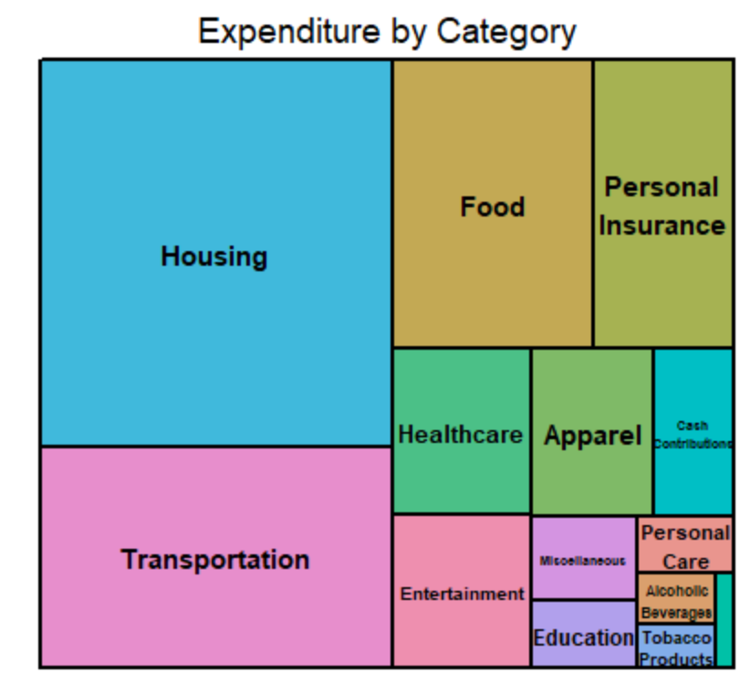
R – Tree Chart

Slide 6
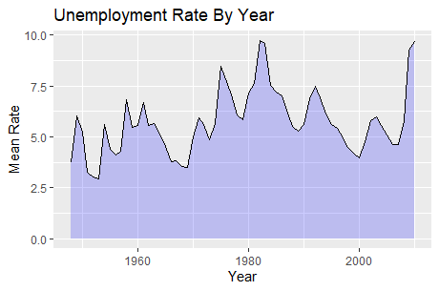
R – Area Chart

Slide 7
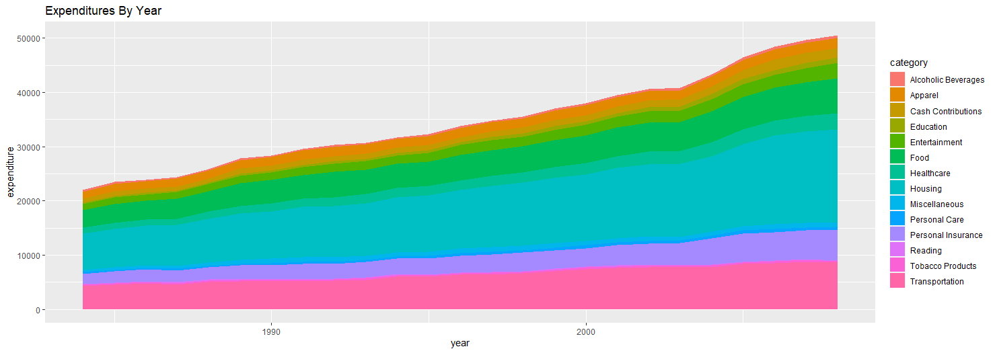
R – Stacked Area Chart

Slide 8
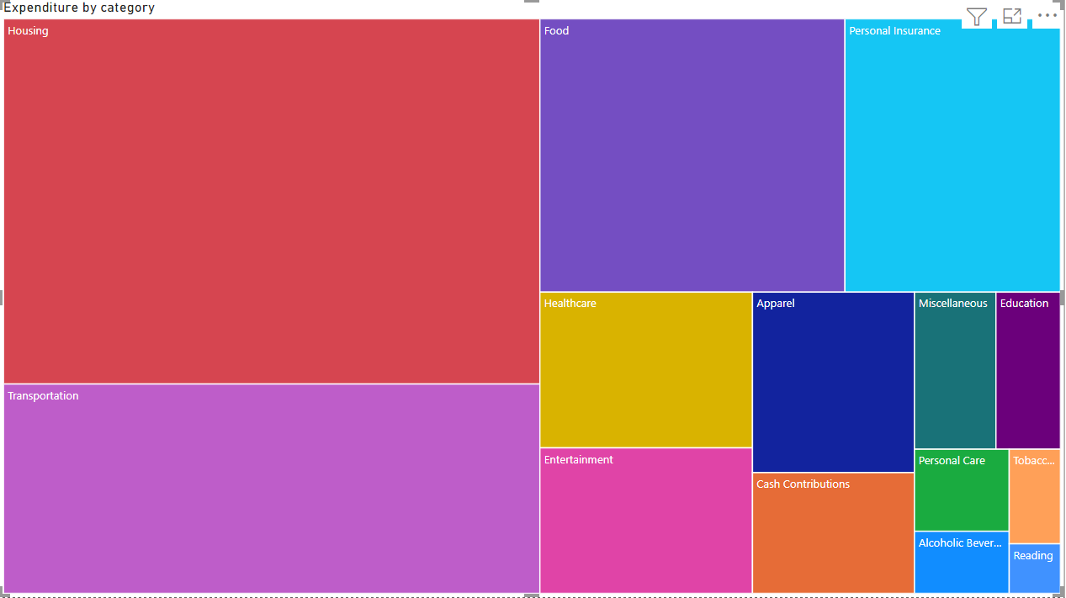
Power BI – Tree Chart

Slide 9
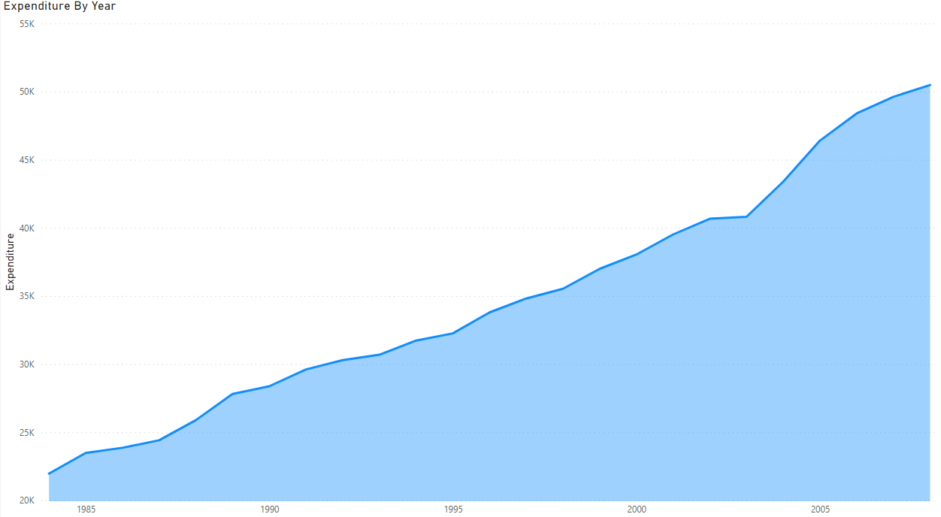
Power BI – Area Chart

Slide 10
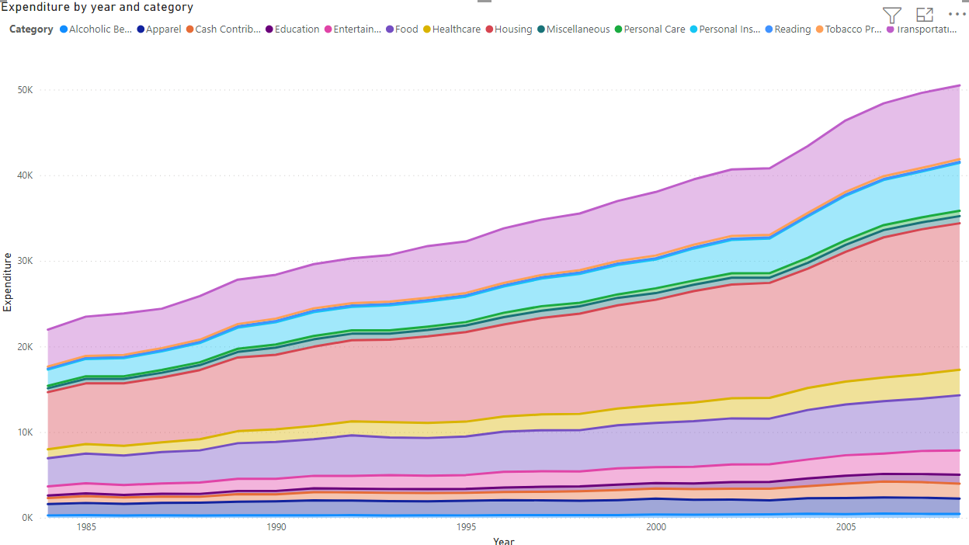
Power BI – Stacked Step Chart

